Slide 1
CHAPTER 5
Introduction to Risk, Return, and the Historical Record

Slide 2
Interest Rate Determinants
5-<number>
Supply
  Households
Demand
  Businesses
Government’s Net Supply and/or Demand
  Federal Reserve Actions

Slide 3
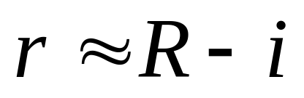
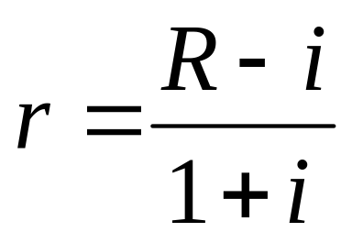
Real and Nominal Rates of Interest
5-<number>
Nominal interest rate: Growth rate of your money
Real interest rate: Growth rate of your purchasing power
Let R = nominal rate, r = real rate and I = inflation rate. Then:

Slide 4
Equilibrium Real Rate of Interest
5-<number>
Determined by:
  Supply
  Demand
  Government actions
  Expected rate of inflation

Slide 5
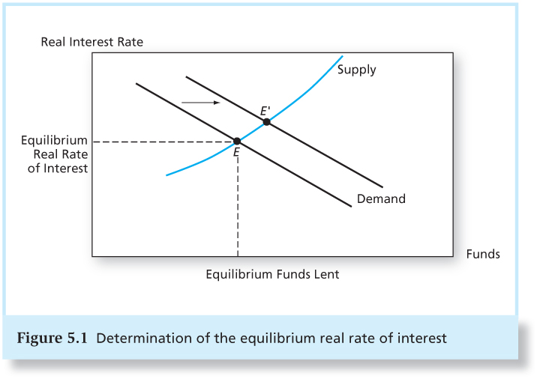
Figure 5.1 Determination of the Equilibrium Real Rate of Interest
5-<number>

Slide 6
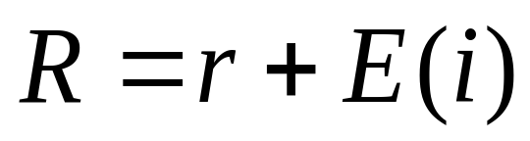
Equilibrium Nominal Rate of Interest
5-<number>
As the inflation rate increases, investors will demand higher nominal rates of return
If E(i) denotes current expectations of inflation, then we get the Fisher Equation:
Nominal rate = real rate + inflation forecast

Slide 7
Taxes and the Real Rate of Interest
5-<number>
Tax liabilities are based on nominal income
  Given a tax rate (t) and nominal interest rate (R), the Real after-tax rate is:
The after-tax real rate of return falls as the inflation rate rises.

Slide 8
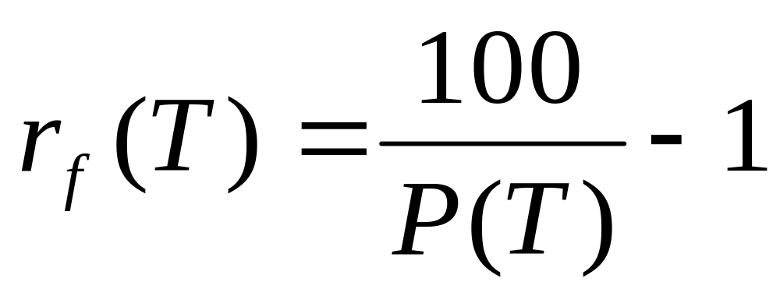
Rates of Return for Different Holding Periods
5-<number>
Zero Coupon Bond, Par = $100, T=maturity, P=price, r_{f}(T)=total risk free return

Slide 9
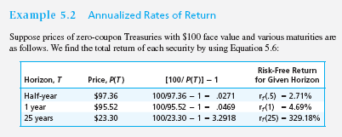
Example 5.2 Annualized Rates of Return
5-<number>

Slide 10
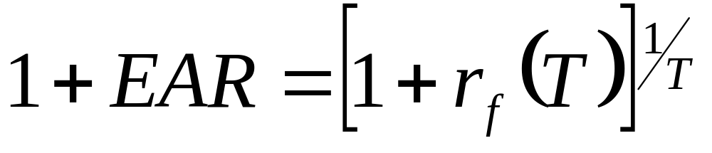
Equation 5.7 EAR
5-<number>
EAR definition: percentage increase in funds invested over a 1-year horizon

Slide 11
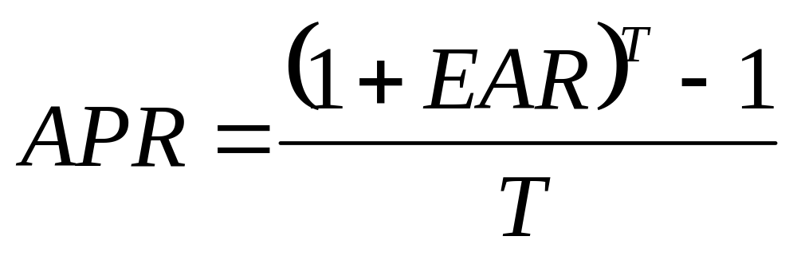
Equation 5.8 APR
5-<number>
APR: annualizing using simple interest

Slide 12
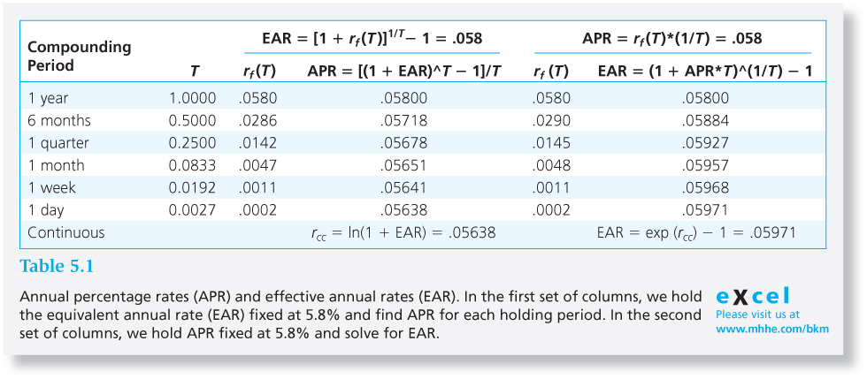
Table 5.1 APR vs. EAR
5-<number>

Slide 13
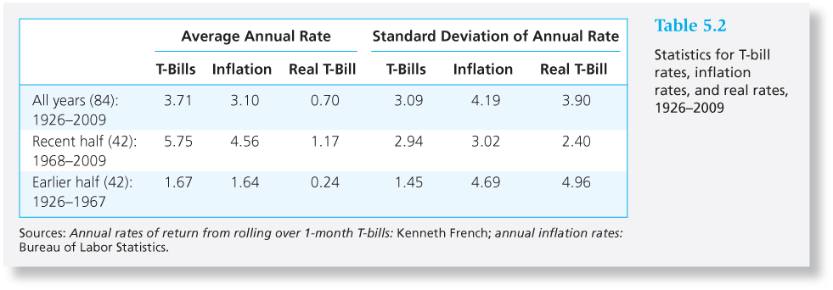
Table 5.2 Statistics for T-Bill Rates, Inflation Rates and Real Rates, 1926-2009
5-<number>

Slide 14
Bills and Inflation, 1926-2009
5-<number>
Moderate inflation can offset most of the nominal gains on low-risk investments.
A dollar invested in T-bills from1926–2009 grew to $20.52, but with a real value of only $1.69.
Negative correlation between real rate and inflation rate means the nominal rate responds less than 1:1 to changes in expected inflation.

Slide 15
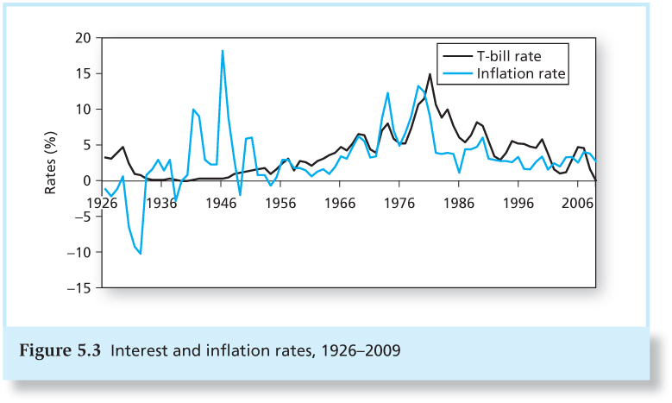
Figure 5.3 Interest Rates and Inflation, 1926-2009
5-<number>

Slide 16
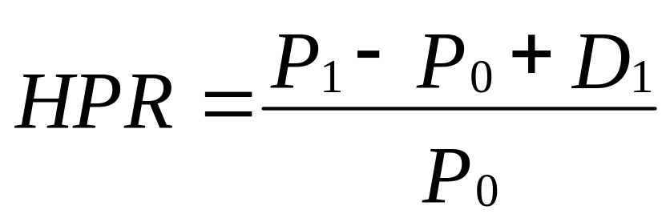
Risk and Risk Premiums
5-<number>
Rates of Return: Single Period
HPR = Holding Period Return
P₀ = Beginning price
P₁ = Ending price
D₁ = Dividend during period one

Slide 17
Rates of Return: Single Period Example
5-<number>
Ending Price = 110
Beginning Price = 100
Dividend = 4
HPR = (110 - 100 + 4 )/ (100) = 14%

Slide 18
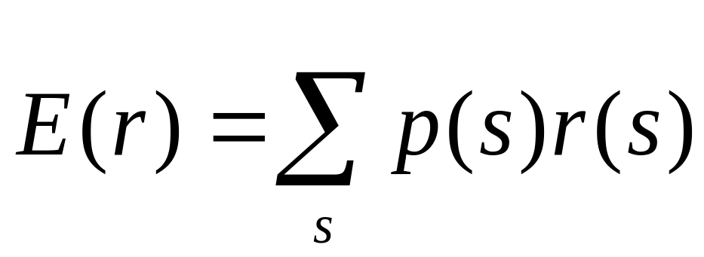
Expected Return and Standard Deviation
5-<number>
Expected returns
p(s) = probability of a state
r(s) = return if a state occurs
s = state

Slide 19
Scenario Returns: Example
5-<number>
State Prob. of State r in State
Excellent .25 0.3100
Good .45 0.1400
Poor .25 -0.0675
Crash .05 -0.5200
E(r) = (.25)(.31) + (.45)(.14) + (.25)(-.0675)
+ (0.05)(-0.52)
E(r) = .0976 or 9.76%

Slide 20
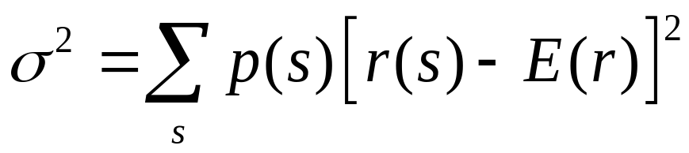
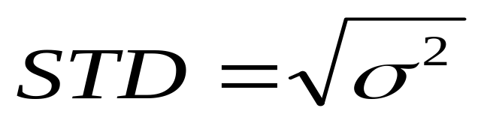
Variance and Standard Deviation
5-<number>
Variance (VAR):
Standard Deviation (STD):

Slide 21
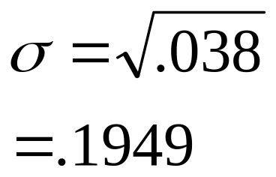
Scenario VAR and STD
5-<number>
Example VAR calculation:
  σ² = .25(.31 - 0.0976)²+.45(.14 - .0976)² + .25(-0.0675 - 0.0976)² + .05(-.52 - .0976)²
  = .038
Example STD calculation:

Slide 22
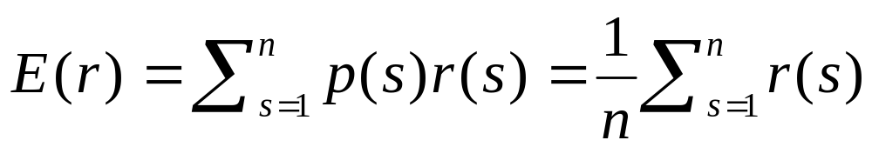
Time Series Analysis of Past Rates of Return
5-<number>
The Arithmetic Average of rate of return:

Slide 23
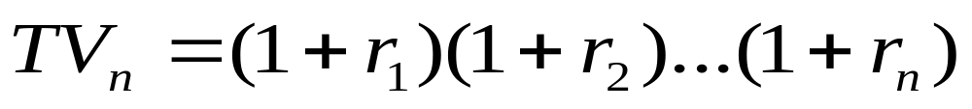
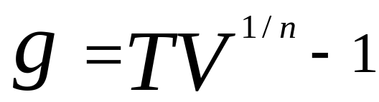
Geometric Average Return
5-<number>
TV = Terminal Value of the Investment
g= geometric average rate of return

Slide 24
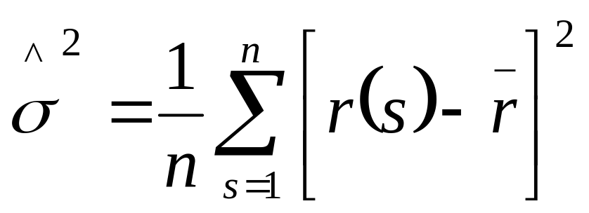
Geometric Variance and Standard Deviation Formulas
5-<number>
Estimated Variance = expected value of squared deviations

Slide 25
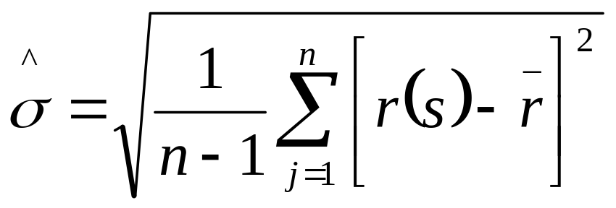
Geometric Variance and Standard Deviation Formulas
5-<number>
When eliminating the bias, Variance and Standard Deviation become:

Slide 26
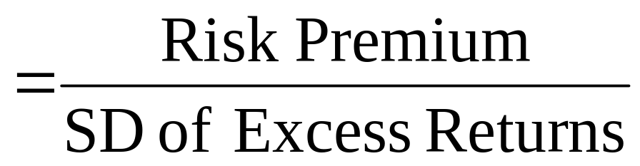
The Reward-to-Volatility (Sharpe) Ratio
5-<number>
Sharpe Ratio for Portfolios:

Slide 27
The Normal Distribution
5-<number>
Investment management is easier when returns are normal.
  Standard deviation is a good measure of risk when returns are symmetric.
  If security returns are symmetric, portfolio returns will be, too.
  Future scenarios can be estimated using only the mean and the standard deviation.

Slide 28
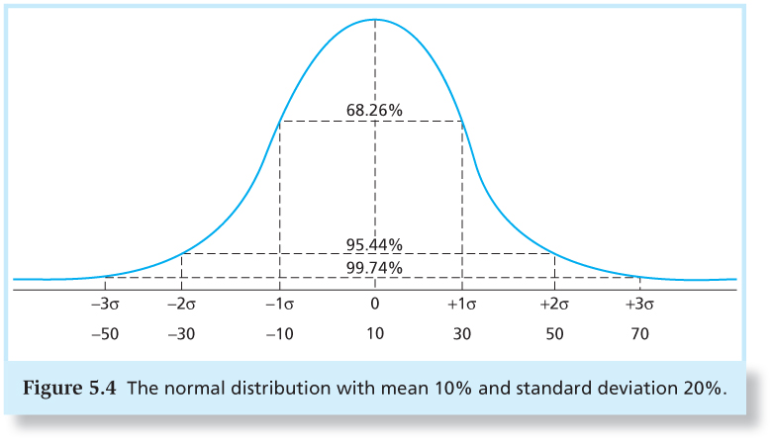
Figure 5.4 The Normal Distribution
5-<number>

Slide 29
Normality and Risk Measures
5-<number>
What if excess returns are not normally distributed?
  Standard deviation is no longer a complete measure of risk
  Sharpe ratio is not a complete measure of portfolio performance
  Need to consider skew and kurtosis

Slide 30
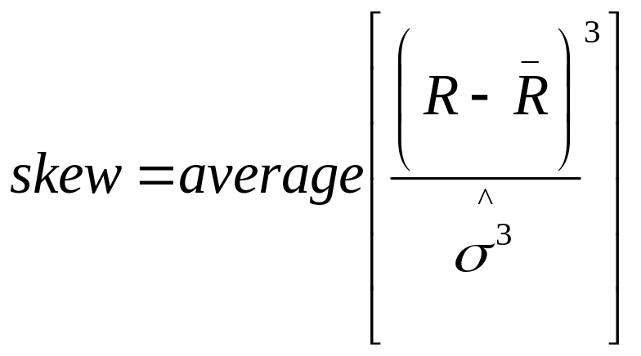
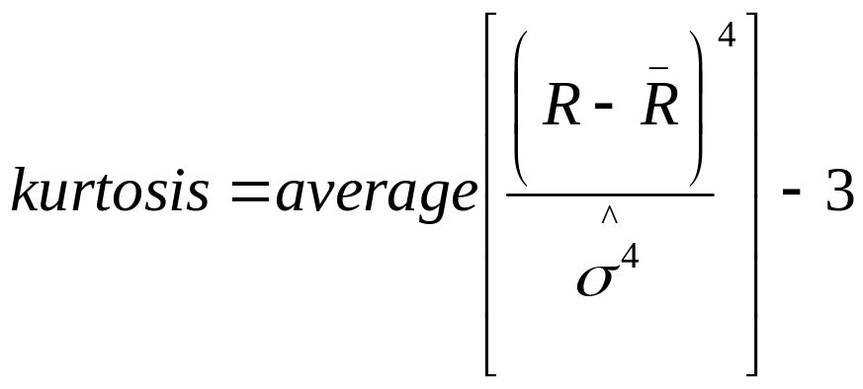
Skew and Kurtosis
5-<number>
Skew
Kurtosis
Equation 5.19
Equation 5.20

Slide 31
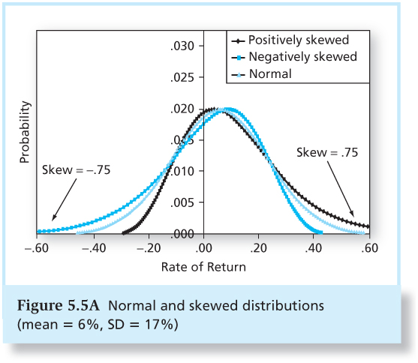
Figure 5.5A Normal and Skewed Distributions
5-<number>

Slide 32
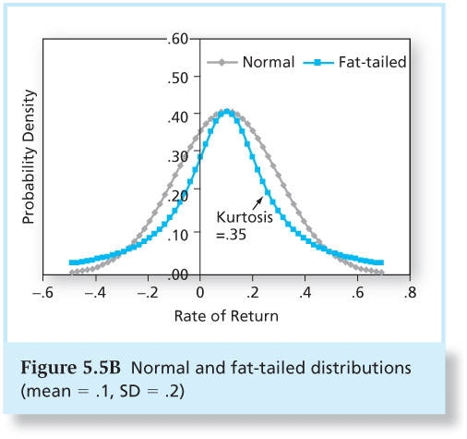
Figure 5.5B Normal and Fat-Tailed Distributions (mean = .1, SD =.2)
5-<number>

Slide 33
Value at Risk (VaR)
5-<number>
A measure of loss most frequently associated with extreme negative returns
VaR is the quantile of a distribution below which lies q % of the possible values of that distribution
  The 5% VaR , commonly estimated in practice, is the return at the 5th percentile when returns are sorted from high to low.

Slide 34
Expected Shortfall (ES)
5-<number>
Also called conditional tail expectation (CTE)
More conservative measure of downside risk than VaR
  VaR takes the highest return from the worst cases
  ES takes an average return of the worst cases

Slide 35
Lower Partial Standard Deviation (LPSD) and the Sortino Ratio
5-<number>
Issues:
  Need to consider negative deviations separately
  Need to consider deviations of returns from the risk-free rate.
LPSD: similar to usual standard deviation, but uses only negative deviations from r_{f}
Sortino Ratio replaces Sharpe Ratio

Slide 36
Historic Returns on Risky Portfolios
5-<number>
Returns appear normally distributed
Returns are lower over the most recent half of the period (1986-2009)
SD for small stocks became smaller; SD for long-term bonds got bigger

Slide 37
Historic Returns on Risky Portfolios
5-<number>
Better diversified portfolios have higher Sharpe Ratios
Negative skew

Slide 38
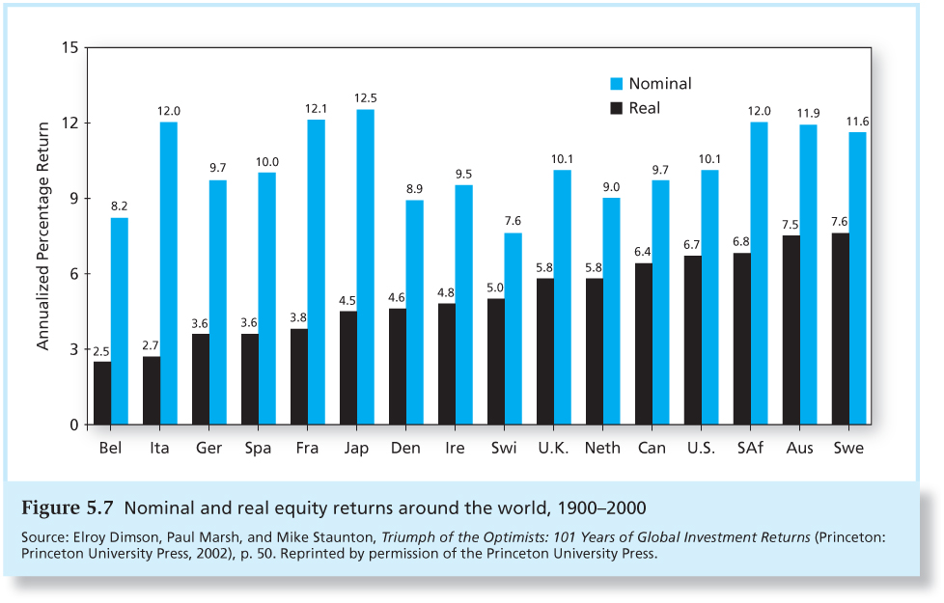
Figure 5.7 Nominal and Real Equity Returns Around the World, 1900-2000
5-<number>

Slide 39
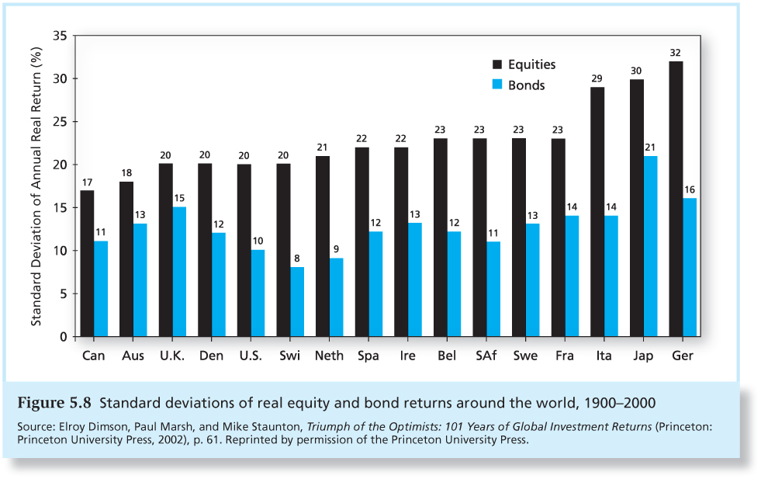
Figure 5.8 Standard Deviations of Real Equity and Bond Returns Around the World, 1900-2000
5-<number>

Slide 40
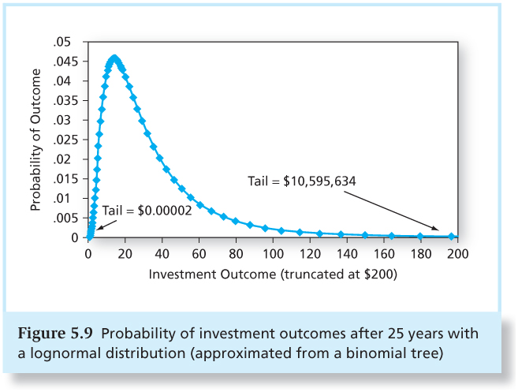
Figure 5.9 Probability of Investment Outcomes After 25 Years with a Lognormal Distribution
5-<number>

Slide 41
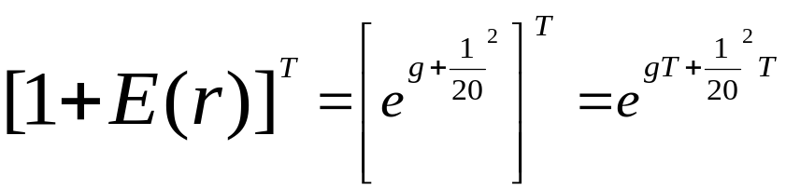
Terminal Value with Continuous Compounding
5-<number>
When the continuously compounded rate of return on an asset is normally distributed, the effective rate of return will be lognormally distributed.
The Terminal Value will then be:

Slide 42
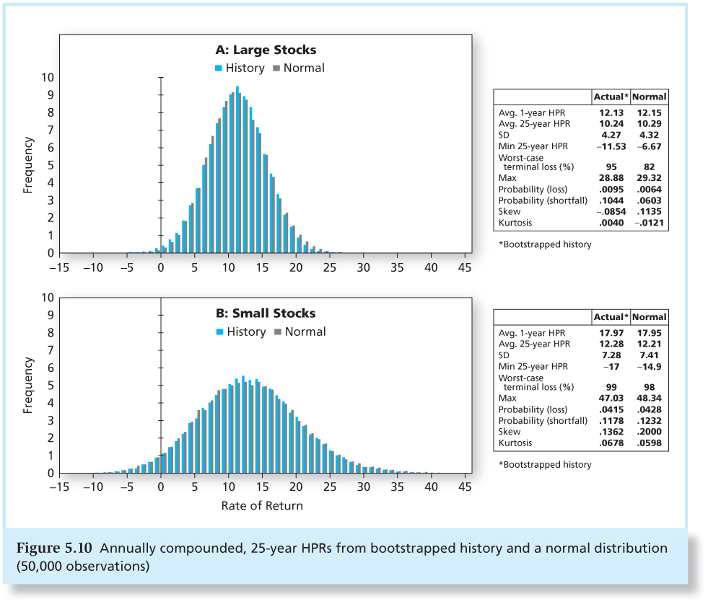
Figure 5.10 Annually Compounded,
25-Year HPRs
5-<number>

Slide 43
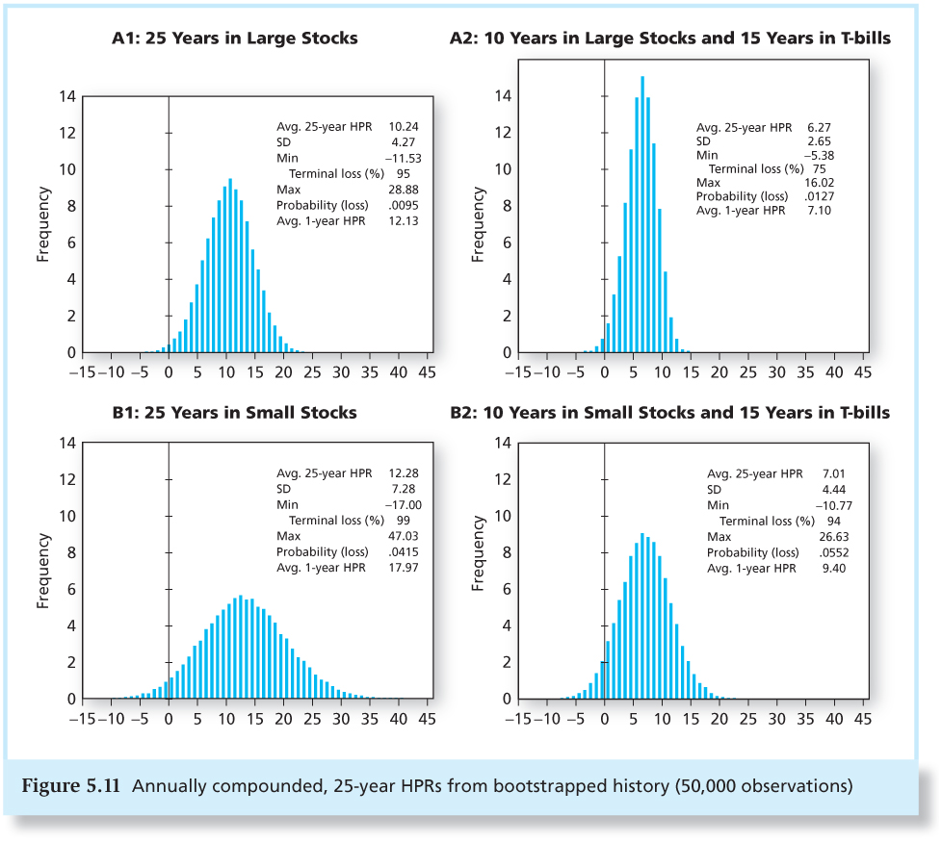
Figure 5.11 Annually Compounded,
25-Year HPRs
5-<number>

Slide 44
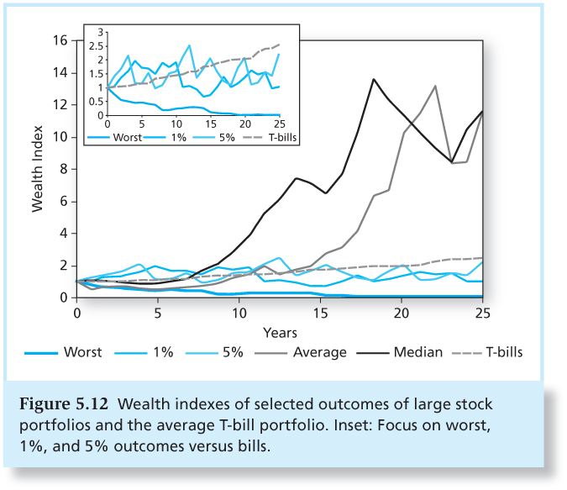
Figure 5.12 Wealth Indexes of Selected Outcomes of Large Stock Portfolios and the Average T-bill Portfolio
5-<number>

